Slide 1

Health Information Exchange: Using Health Information Technology to Manage Covid-19 Pandemic

Slide 2
Names of Group Members
Members

Slide 3

Introduction
Health information exchange (HIE) is the mobilization of health care information which is shared electronically across organizations which are located within a community, region or hospital system
It allows pharmacists, nurses, doctors and other health care providers as well as patients to access and securely share a patient’s data.
Notes:
Health information exchange (HIE) is a repository of information regarding patients and other important healthcare details which are shared across organizations (Dixon, 2016). This allows the healthcare professionals to have access to important details about a patient.

Slide 4
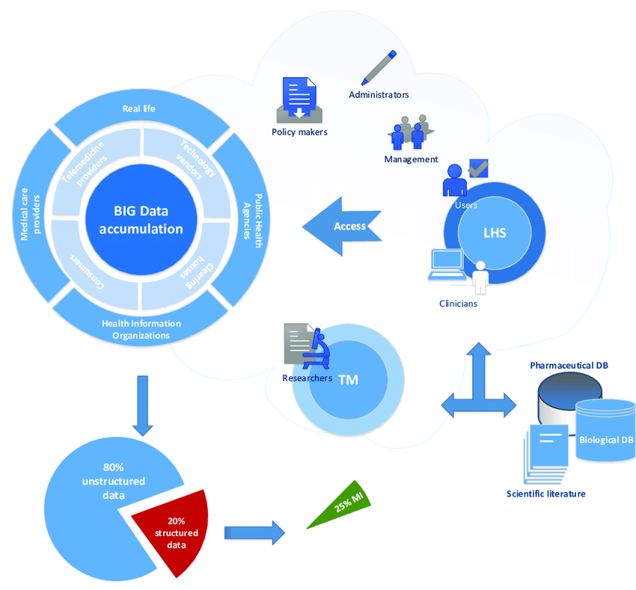
Importance of the Content
This content is vital since it:
Improves health care quality.
Safety.
Patient outcomes.
Reduces medical errors.
Notes:
Information that is shared across the healthcare system helps in reducing medical errors by the healthcare professionals such as doctors and nurses. It helps improve health care quality, safety as well as the patient’s outcomes.

Slide 5

Cont…,
Timely sharing of important patient data will improve decision making at the point of care and give the providers an opportunity to:
Improve diagnoses.
Avoid making medication errors.
Avoid unwanted readmissions.
Reduce duplicate testing
Notes:
Sharing of vital information about the patients will help the healthcare providers in avoiding readmissions, improve diagnoses and avoid medical errors as well as duplication of testing (Dixon, 2016).

Slide 6
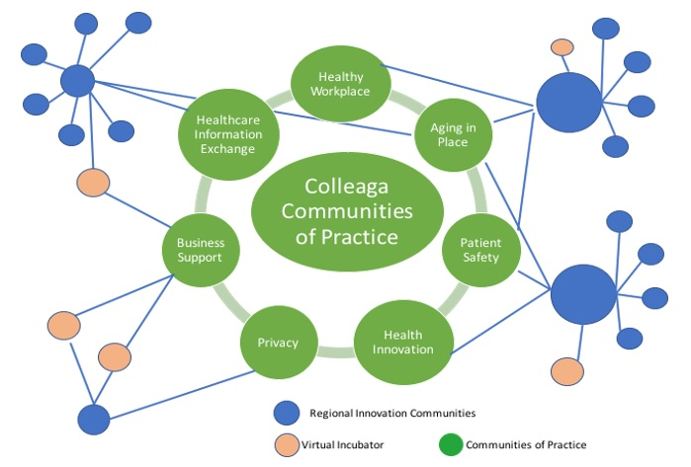
Background Information
Health information exchange involves sharing of vital healthcare information.
It breaks the boundaries of states, health data banks and health care institutions.
Many healthcare stakeholders have realized that sharing of this details will improve the healthcare sector with respect to cost, quality and safety.
Sharing such data is faced by issues of data ownership, privacy, competing priorities and financial concerns.
Notes:
Health information exchange has helped in breaking the boundaries of states, health care banks and health care institutions. Many of the health care shareholders have realized that with sharing of this data will result in reducing the cost, quality and safety of the patients. However, this sharing of patient’s data has faced various issues which are privacy, data ownership, financial and competing priorities.

Slide 7

Definition of Key Concepts
Health information technology participants. Which includes participants such as government agencies, tech companies, medical facilities and research institutions.
Technologies. This involves various emerging technologies such as cloud computing, big data and the IoT (Ye Zhou & Wu, 2020).
Service recipients. This are confirmed patients, close contacts, suspected patients and the public
Notes:
The key concepts in this case are technologies, health information technology participants and service recipients (Ye, et al., 2020).

Slide 8
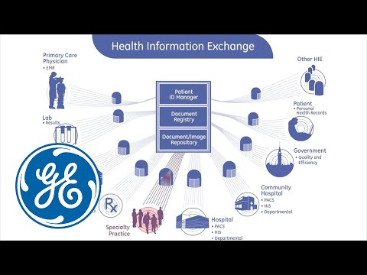
Impact to Workflow
Health information exchange has improved the workflow within the healthcare industry.
It has eased the way information has been shared.
Sharing of the patient's records has improved the speed and quality of health care services provided.
There has been a smooth flow of work ensuring safety of the patients.
Notes:
Sharing of patient’s data has been improving workflow within the healthcare system. Health information exchange has improved the flow of health-related information from one point to another and therefore leading to improving patient's outcomes as well as their safety (Ashfaque, 2020).

Slide 9
Implementation Process
Task | Owners | Progress made | Due date
Identification of information required for sharing | Student’s name | Identified some of the necessary information | 1st January 2021
HIE Governance and Organization | Student’s name | Identified some of the governance rules of HIE | 31st December 2020
Provision of IT Capability to Identify Records | Student’s name | Created the platform to feed data | 31st December 2020
Creation of a Full-fledged Query System | Student’s name | Created some several queries | 31st December 2020

Slide 10
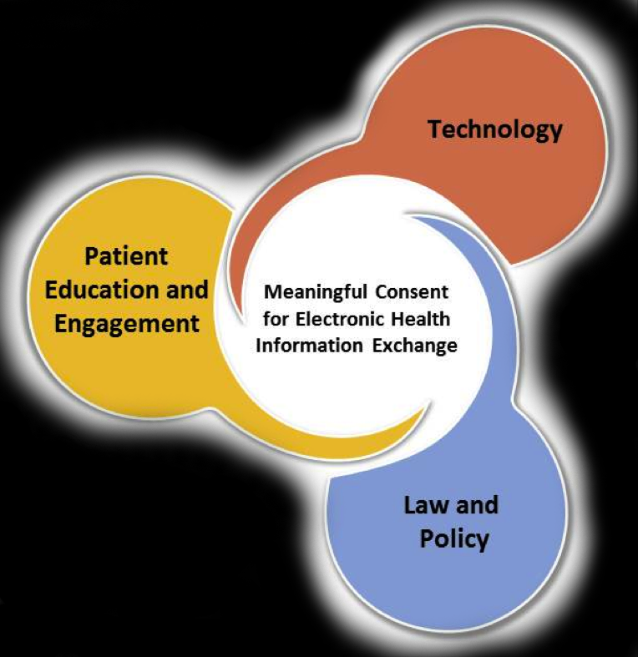
Challenges during Implementation
Authorization by the patient’s to share the data.
Legal risks
Ensuring health data privacy.
Inadequate broadband and internet infrastructure.
Workflow issues.
Notes:
There are various challenges that we came across during the implementation of the HIE project. One of the issues that I came across is that of authorization by the patient’s to share data. The rest of the challenges are legal risks, and ensuring health data privacy, just but to mention a few.

Slide 11
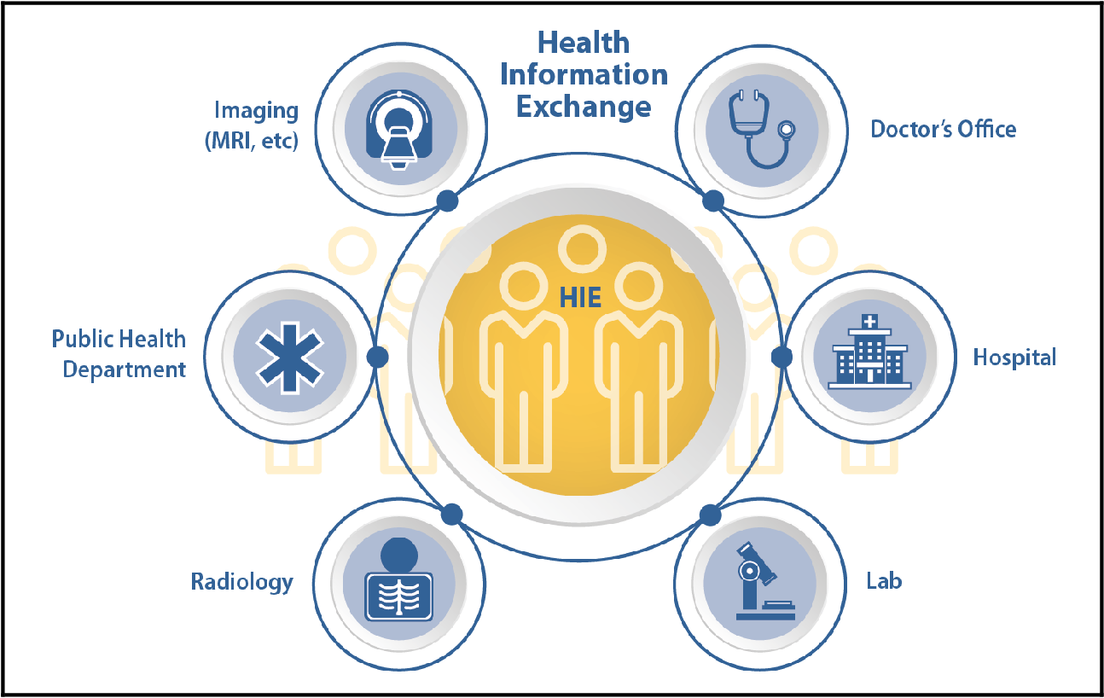
Support Process
The support process involved bringing onboard key players who were to make the implementation of the HIE system possible.
This key players involves:
Healthcare professionals.
Patients.
Providers of IT infrastructures.

Slide 12

Challenges after Implementation
Identification as well as correcting wrong or missing healthcare information.
Rules guiding sharing of health information.
Changes in partner’s priorities.
Incomplete data.
Notes:
After having set up the HIE system, there were various challenges linked to running of the system which included; incomplete data and rules guiding sharing of health information, just but to mention a few (Ashfaque, 2020).

Slide 13
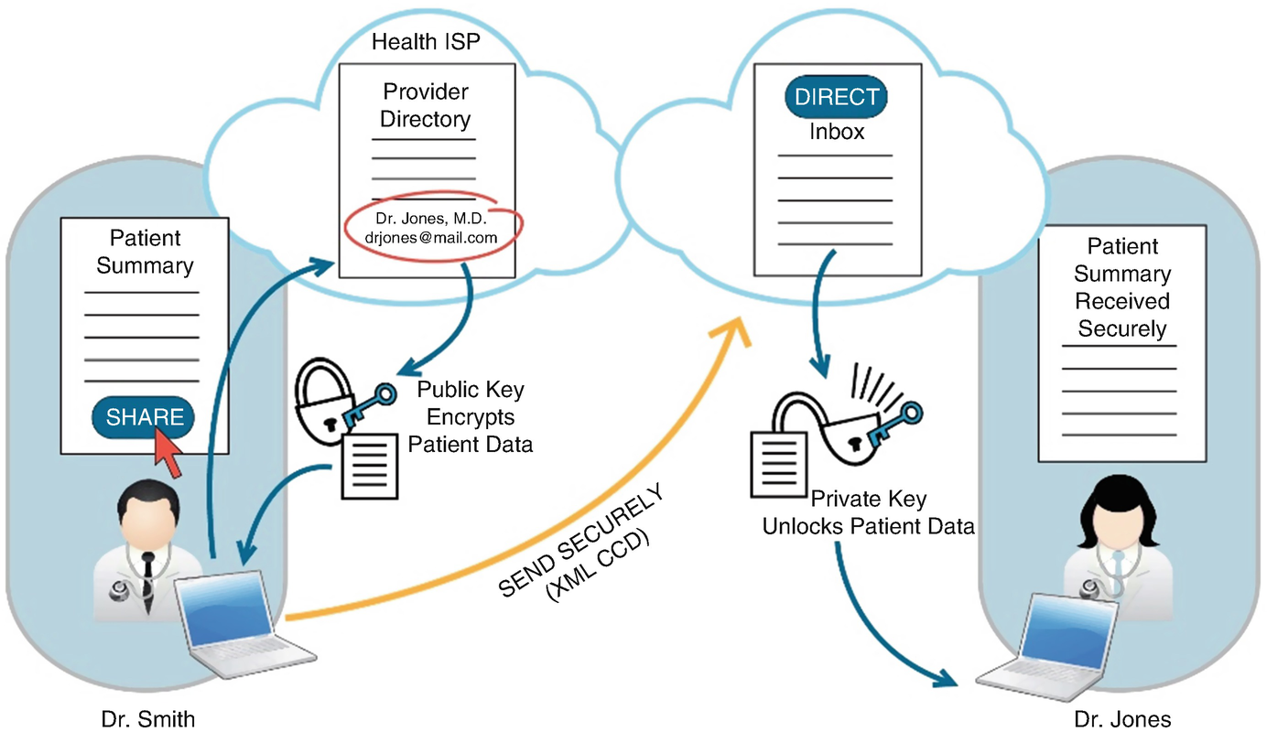
Popular Vendors
Some of the popular vendors of healthcare information systems include:
Meditech
Siemens
Allscripts
Notes:
The most popular vendors of the health information systems are Meditech, Siemens and Allscripts.

Slide 14
Comparison of Popular Vendors
Siemen | Allscripts | Meditech
Practice management system | Electronic health record | Laboratory information system

Slide 15

Future of Health Information System
There will be develop rapid response of electronic health records to emergencies.
Increased capability of rapid deployment of information gathered across the system.
Notes:
There is a possibility that the system will ensure that there will be increased speed of sharing of information in order to help curb the spread of Covid-19. Once the data has been gathered by the health care professionals, it will be shared amongst the healthcare facilities across the connected healthcare facilities and agencies.

Slide 16

Conclusion
Rapid adaptation of information system to response public health emergencies.
Health information exchange has helped in ensuring;
Safety of the patients.
Fast sharing of important medical information.
Minimized medical errors.
Improved patient outcome.
Notes:
In conclusion, health information exchange has led to sharing of information across all the interested partners. This sharing of healthcare information has helped in improvements of the patient's outcome, minimization of medical errors and increased safety of the patients

Slide 17
Names of members together with the slides done.
List of students:
Student 1: Slides covered…….
Student 2: slides covered

Slide 18
References
Ashfaque, M. F. (2020). Adoption of the health information exchange (HIE) system and the role of the healthcare leadership.
Dixon, B. E. (2016). Health information exchange: Navigating and managing a network of health information systems.
Ye, Q., Zhou, J., & Wu, H. (2020). Using Information Technology to Manage the COVID-19 Pandemic: Development of a Technical Framework Based on Practical Experience in China. JMIR medical informatics, 8(6), e19515. https://doi.org/10.2196/19515

